Slide 1
Lua Programming
By Eric Bowers, Josh Fleming, Ed Sutton

Slide 2
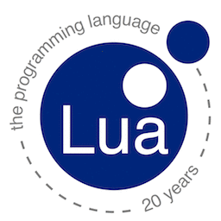
What is the Language Paradigm
Lua is a multi-paradigm language
Scripting language
Imperative language
Functional language

Slide 3
Historical Evolution
Lua was created to be an easy portable language that is quick
Evolved out of SOL and DEL.
Also influenced by modula, CLU, C++, SNOBOL, and AWK

Slide 4
What was different?
It’s a functional language that also incorporates some object oriented ideas
Uses tables as it’s primary data structures. The tables can be used to represent other data types such as arrays

Slide 5
What was helpful?
Using the LUA API
Can run programs off the IDE or command prompt
Don’t have to specify data types
Heavily relies on tables (don’t have to learn a lot of different data structures)
Doesn’t use braces

Slide 6
Best suited for one particular type of application
More of a general purpose scripting language
Also used in games because it is portable, small, and powerful. LUA logic good for AI

